Slide 1
The genetic basis of C.elegans natural variation of propionic acid sensitivity
Huimin Na
Jun 22nd, 2018
Notes:
Today I am going to talk about recent progress of a collaboration project with Erik anderson’s lab which is using genome wide association study to find out the genetic basis of C. elegans natural variation of propionic acid sensitivity.

Slide 2
12 genetically distinct strains behave differently to propionic acid
N2
Notes:
----- 会议笔记(10/25/16 11:40) -----
at first, they send me 12 genetically distinct c.elegans strains and PA toxicity assay result show that most of the sam behave similar, just as N2

Slide 3
Heritability analysis: chose 100mM as working dose for large panel assay
Notes:
----- 会议笔记(2/7/17 09:32) -----
so they calculate the herdity to show that what is the propotion of genetic factors contribute to the PA resistance and at what concentration of PA that genetic factors contribute the most.

Slide 4
6 strains were selected as control of each replicate
Notes:
The 6 strains were chosen as controls because they show different but stable performance to high concentration PA.

Slide 5
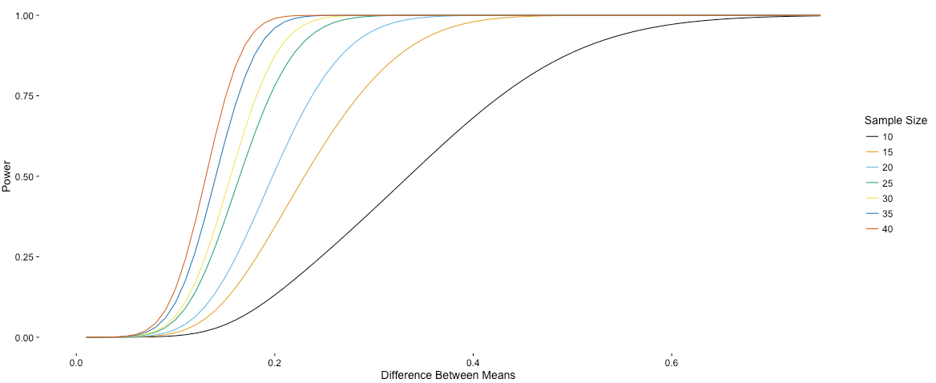
Power calculation to determine sample size
Notes:
Please find Stefan's power calculations attached. He assumed that Nana will do five biological replicates and then tested how many technical replicates are required.

Slide 6
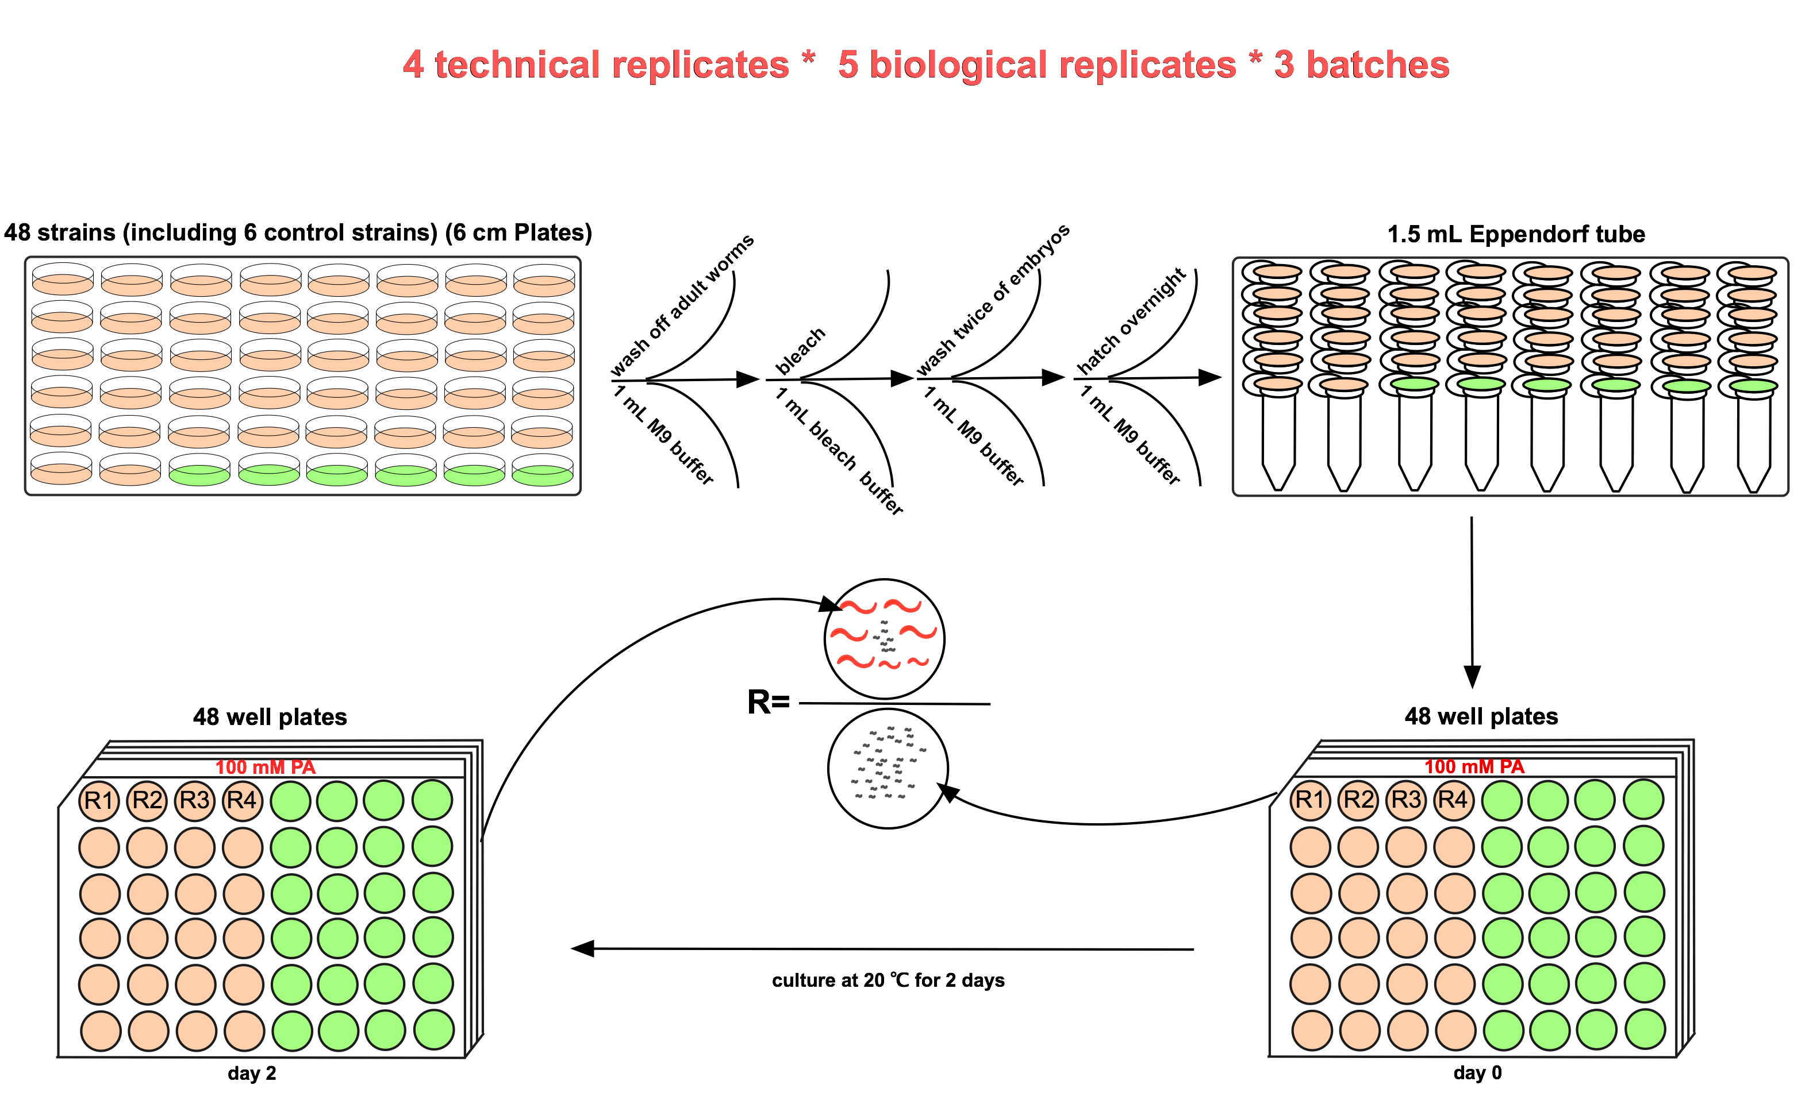
131 wild isolated strains PA toxicity assay
Notes:
Then we chose 100mM as the working dose to test more strains. In total 3 batches experiments were carried out, each batch includes 48 strains. with 4 technical plus 5 biological replicates. Within each experiment, 6 strains were included as controls, which were labeled as green in the diagram.

Slide 7
131 C. elegans wild isolates propionic acid toxicity
Batch1
Batch2
Batch3
Notes:
Xls file of all the strain names and all tested strain names
What I did is test 100mM propionic acid sensitivity of 131 wild isolated C.elegans strains and through genome wide association study to identify which genome region contribute to the Survival rate. The assay was done in 48 well plates for 3 batches, each time include 6 strains as batch effect control, each dot represent one experiment, 4 technical plus 5 biological, 20 dots in total. Red line indicate the average number of 20 dots.
In population genetics, linkage disequilibrium is the non-random association of alleles at different loci in a given population.

Slide 8
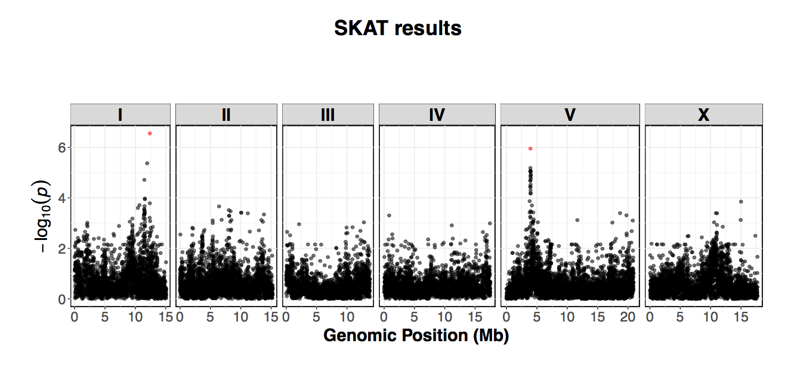
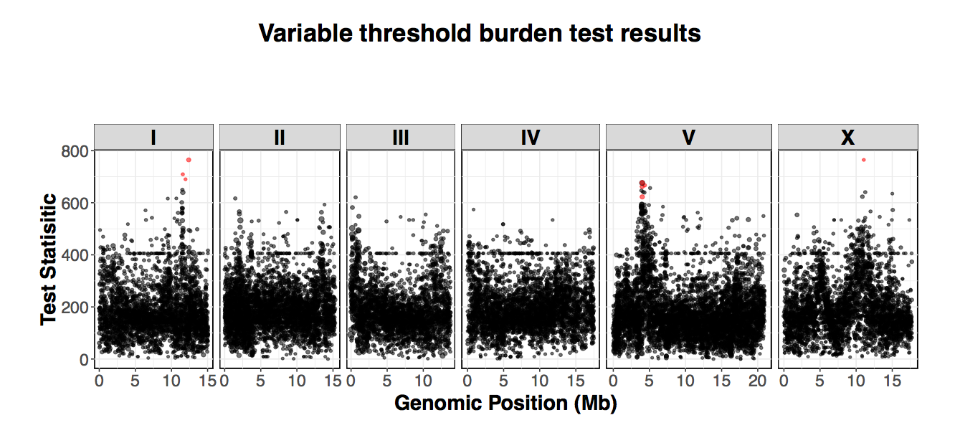
3 different mapping methods all indicate QTL on left arm of chromosome V
Notes:
Then Stefan in Erik’s lab calculated the QTL located on the left arm of chromosome V. This is single marker association mapping.

Slide 9
NIL(near-isogenic line) building
sensitive
resistant
BRC20067
DL238
X
3
3.5
4.3
5.4
Q—T—L
ChrV
Left
out
Left
Right
Right
out
Notes:
Erik send me two files: How to build NIL and how to do introgression.
We chose 2 strains, one is resistant to PA, one is sensitive to PA, and swap the genomic region contain QTLs form Resistant to sensitive strains, then we have a new near isogenic line.

Slide 10
1st & 2nd round introgression of NIL strains
1. A8, A9, A12, B2, B3, B4
NIL strains
2. A3, A6
3. B6, B12
4. B9
5. B10, C1
NIL interval strains
6. B8, C5
7. C6
Notes:
Finished X swap of all the 17 strain (C4 can not mate). But since the 17 strain are from several F5, for introgression part, only carried out for 7 strains, 2 are real “NIL” strain, other 5 are for further mapping.

Slide 11
NIL strain genotypes (Round 1&2)
Sensitive
Resistant

Slide 12
NIL strain genotypes (Round 1&2)
 |  | 1 | 2 | 3 | 4 | 5 | 6 | 7 | 8 | 9 | 10 | 11 | 12
 | Genomic location | A3 | A6_R2 | B2 | B3 | A6_R1 | B6 | B8 | B9 | B10 | C6 | BRC20067 | DL238
Leftout_A7 | V:3096975-3097641 | - | - | - | - | - | - | - | - | - | - | - | +
Left_C2 | V:3504515-3505301 | + | + | + | + | - | - | - | - | - | - | - | +
Left_C9 | V:3542692-3543404 | + | + | + | + | - | - | - | - | - | - | - | +
Right_D1 | V:4344262-4344867 | + | + | + | + | + | + | + | + | + | + | - | +
Right_D4 | V:4393127-4393882 | + | + | - | - | - | + | - | + | + | - | - | +
Rightout_D5 | V:4989989-4990709 | - | - | - | - | - | - | - | - | - | - | - | +

Slide 13
NIL lines genomic DNA extraction for sequencing
A6
B2
B6
B8
B9
C6
12K

Slide 14
NIL strain genome sequencing results

Slide 15
NIL strain propionic acid sensitivity test

Slide 16
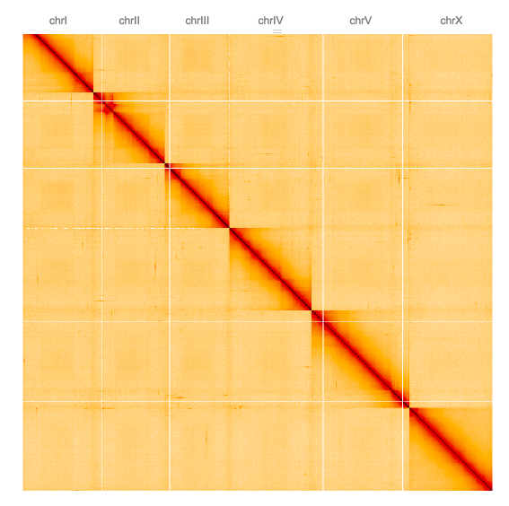
DL238 genome assembly
DL238 HiC data is available
Notes:
When Hakan from job’s lab looked at the heatmaps, he saw some clear translocations and gaps

